Slide 1
Case Presentation
Ryan Binley 100220465
Rekha Sihota 100068192
Abdul Rehman 100327994
Brian Nadjiwon 100251108

Slide 2
Story
Investigation of a suspected exchange ring dealing in illicit images
Suspects used steganography, file deletion and manipulation to hide evidence
Required use of steganalysis, file recovery, and exif analysis

Slide 3
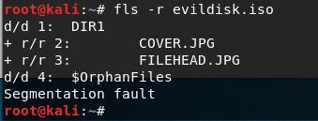
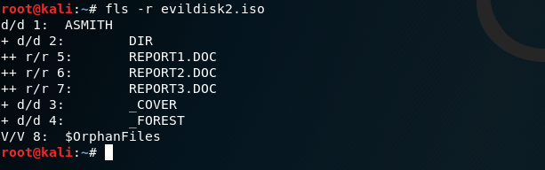
Forensic Evidence

Slide 4
Forensic Tools
Binwalk
Sleuthkit
Steghide
Testdisk
Photorec

Slide 5


Hiding Files

Slide 6
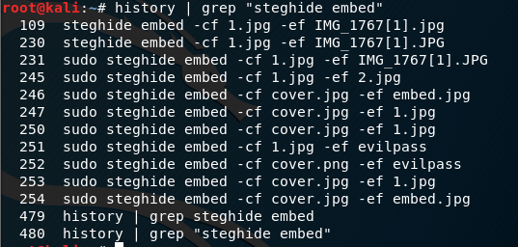
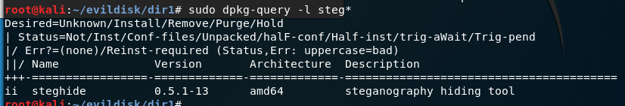
Detecting Steganography - Installed Programs and Recent Commands

Slide 7


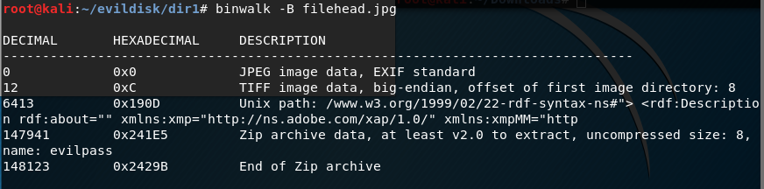
Detecting Steganography - File Headers and Signatures

Slide 8
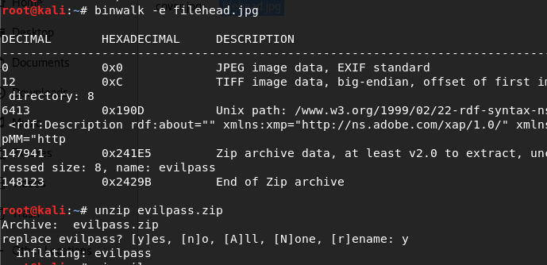

Detecting Steganography - Extracting Hidden Files

Slide 9
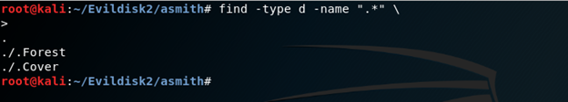
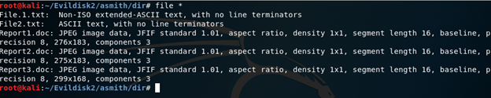
Hidden Directories

Slide 10
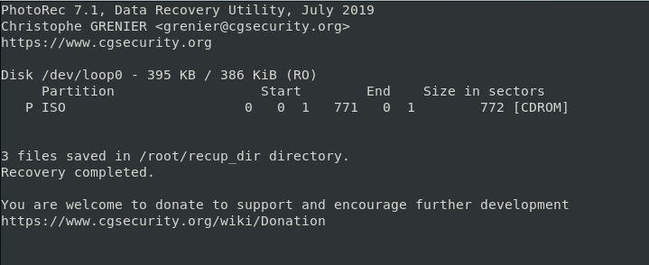
File Recovery Using PhotoRec

Slide 11
Extracting location information from Image
Used the website ExifInfo.org to extract metadata from image.
Image that is uploaded to the ExitInfo.org website and metadata is extracted
Contains information about the image, such as color, resolution and image type.
Contains information about the camera settings such the camera type, ISO, ISO setting, exposure length and lens settings.
When the image is taken is taken with a cellular phone that is GPS capable, the location of where the picture was taken is also stored in metadata of the image.

Slide 12
Conclusion
Identified possible signs of steganographic use, including presence of related software on suspect machine, contextual clues, and file headers
Extracted hidden files using Binwalk and Steghide
Found evidence of deletion or obscuring of file existence
Recovered using Testdisk and Photorec
Extracted Exif data and determined location

Slide 13
Questions?

